Slide 1
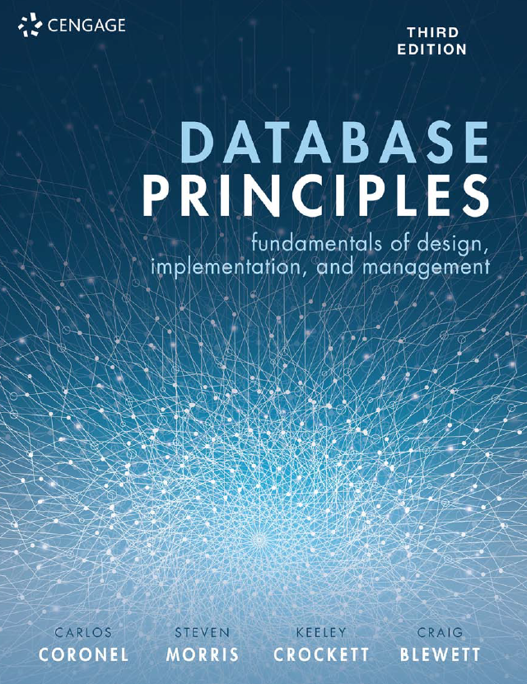
Database Principles Fundamentals of Design, Implementation, and Management
Carlos Coronel, Steven Morris,
Keeley Crockett, Craig Blewett
CHAPTER 4
RELATIONAL ALGEBRA AND CALCULUS

Slide 2
In this chapter, you will learn:
What is meant by relational algebra and relational calculus
How to manipulate database tables using relational set operators
How the DBMS supports the key relational operators: select, project and join.
The different types of joins.
How to write queries using relational algebra expressions.
About tuple and domain relational calculus

Slide 3
Relational Algebra
Relational algebra and relational calculus are the mathematical basis for ‘relational databases’.
Proposed by E.F. Codd in 1971 as the basis for defining the relational model.
Relational algebra…….
Defines theoretical way of manipulating table contents using relational operators
Use of relational algebra operators on existing tables (relations) produces new relations

Slide 4
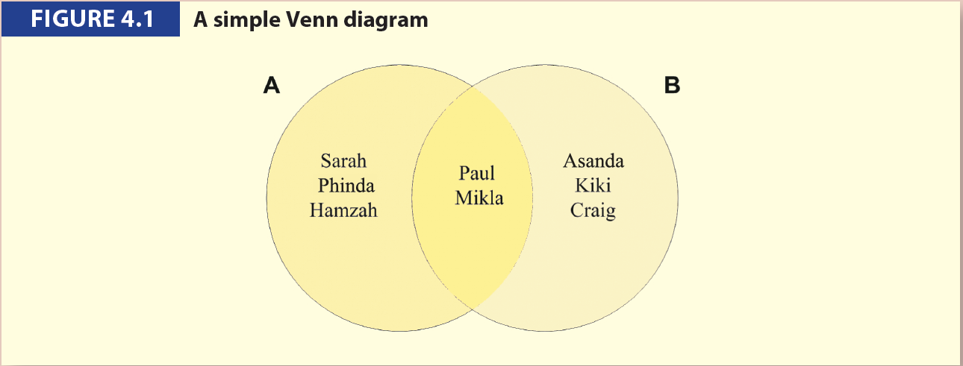
Re-visiting Set Theory

Slide 5
Relational Algebra Operators
UNION
INTERSECT
DIFFERENCE
PRODUCT
SELECT
PROJECT
JOIN
DIVIDE

Slide 6
SELECT
Yields values for all rows found in a table
Can be used to list either all row values or it can yield only those row values that match a specified criterion
Yields a horizontal subset of a table

Slide 7
SELECT (continued)
The SELECT operator denoted by σθ , is formally defined as:
σ_{θ} (R)
or
σ_{<criterion>} (RELATION)
where σθ (R) is the set of specified tuples of the relation R and θ is the predicate (or criterion) to extract the required tuples.

Slide 8
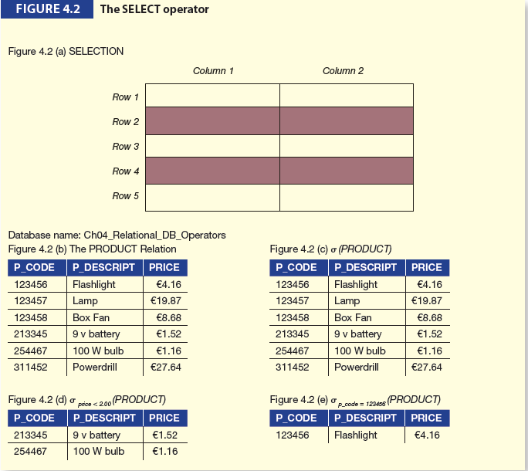
SELECT (continued)

Slide 9
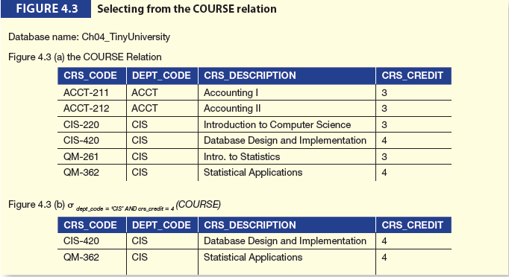
SELECT (continued)

Slide 10
PROJECT
Project
Yields all values for selected attributes
Yields a vertical subset of a table

Slide 11
PROJECT (continued)
The PROJECT operator, denoted by ∏, is formally defined as:
∏ _{a1…an} (R)
or
∏ _{<List of attributes>} (Relation)
where the projection of the relation R, denoted by ∏ _{a1…an} (R) is the set of specified attributes _{a1…an} of the relation R.

Slide 12
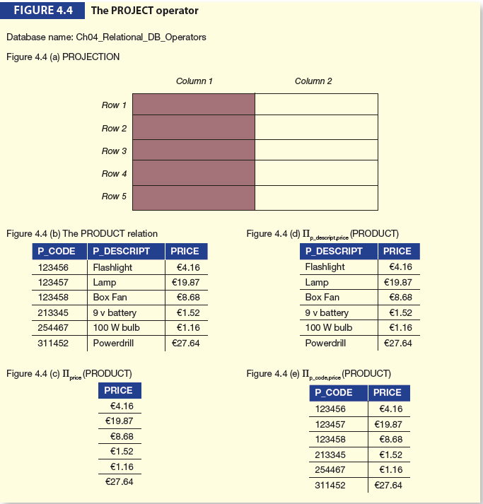
PROJECT (continued)

Slide 13
Union
Union:
Combines all rows from two tables, excluding duplicate rows
Tables must have the same attribute characteristics
When two or more tables share the same number of columns, i.e. have the same degree, and when they share the same (or compatible) domains, they are said to be union-compatible.

Slide 14
Union (continued)
The UNION operator, denoted by ∪, is formally defined as:
The union of relations R1(a1, a2,.... ,an) and R2(b1, b2,...., bn) denoted R1 ∪ R2 with degree n, is the relation R3(c1, c2,.... ,cn) where for each i (i =1,2..n), ai and bi must have compatible domains.

Slide 15
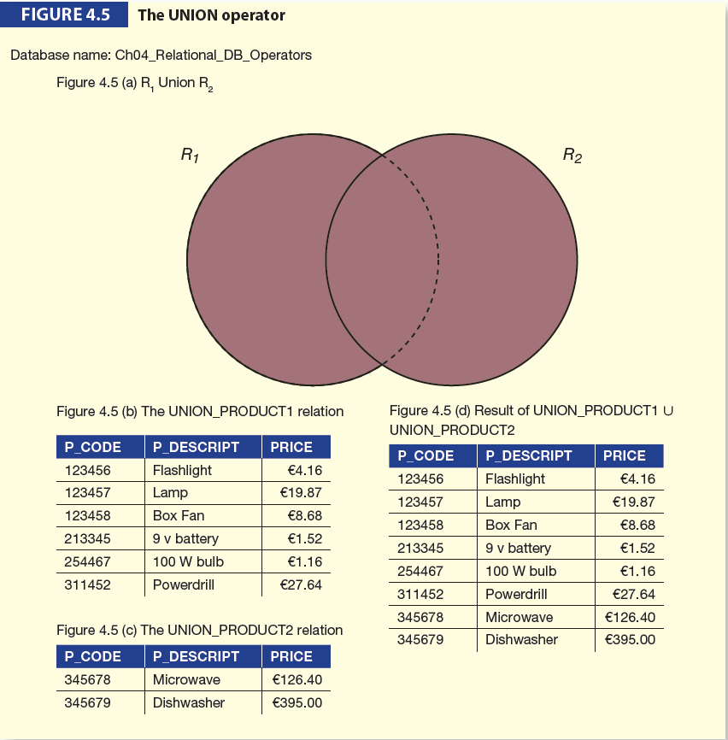
Union (continued)

Slide 16
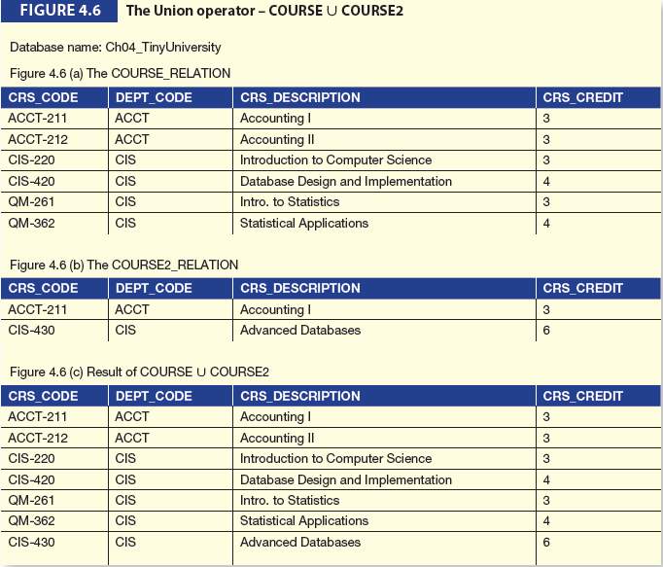
Union (continued)

Slide 17
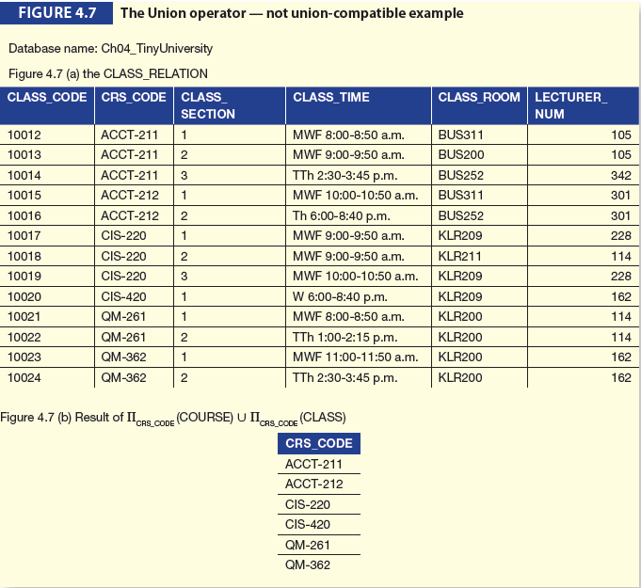
Union (continued)

Slide 18
Intersect
Intersect:
Yields only the rows that appear in both tables
the tables must be union-compatible to give valid results.

Slide 19
Intersect (continued)
The INTERSECT operator is formally defined as:
The intersect of relations R₁(a₁, a₂,.... ,a_{n}) and R₂(b₁, b₂,...., b_{n}) denoted R₁ ∩ R₂ with degree _{n}, is the relation R₃(c₁, c₂,.... ,c_{n}) that includes only those tuples of R₁ that also appear in R₂ where for each i (i =1,2..n), a_{i} and b_{i} must have compatible domains.

Slide 20
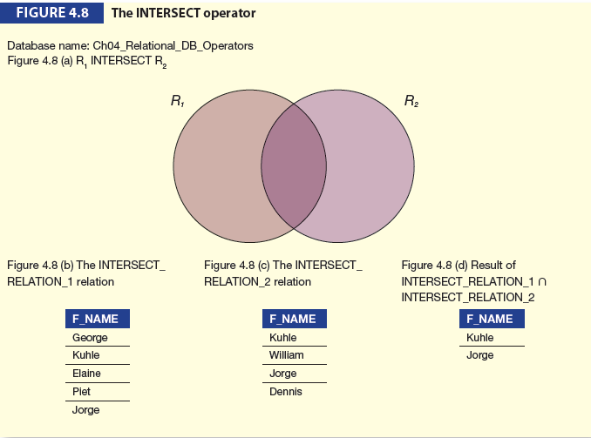
Intersect (continued)

Slide 21
Difference
Difference
Yields all rows in one table not found in the other table — that is, it subtracts one table from the other
The DIFFERENCE operator also requires that the two relations must be union-compatible.

Slide 22
Difference (continued)
The DIFFERENCE operator is formally defined as:
The difference of relations R₁(a₁, a₂,.... ,a_{m}) and R₂(b₁, b₂,...., b_{m}) denoted R₁ - R₂ with degree m, is the relation R₃(c₁, c₂,.... ,c_{m}) that includes all tuples that are in R₁ but not in R₂ where for each i (i =1,2..m), a_{i} and b_{i} must have compatible domains.

Slide 23
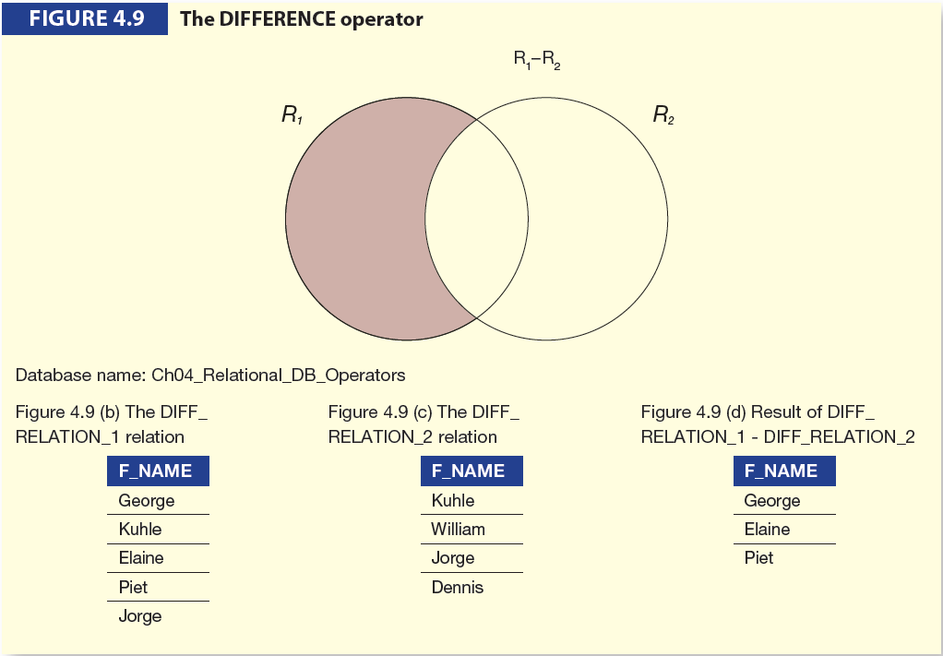
Difference (continued)

Slide 24
Cartesian product
Cartesian product
usually written as R₁ X R₂
Yields all possible pairs of rows from two tables
Also known as the product.

Slide 25
Cartesian product (continued)
It can be formally defined as:
The CARTESIAN PRODUCT of two relations R₁(a₁, a₂,.... ,a_{n}) with cardinality i and R₂(b₁, b₂,...., b_{m})
with cardinality j is a relation R₃ with degree k = n + m, cardinality i*j and attributes (a₁, a₂,.... ,a_{n}, b₁,b₂,...., b_{m}).
This can be denoted as R₃ = R₁ X R₂.

Slide 26
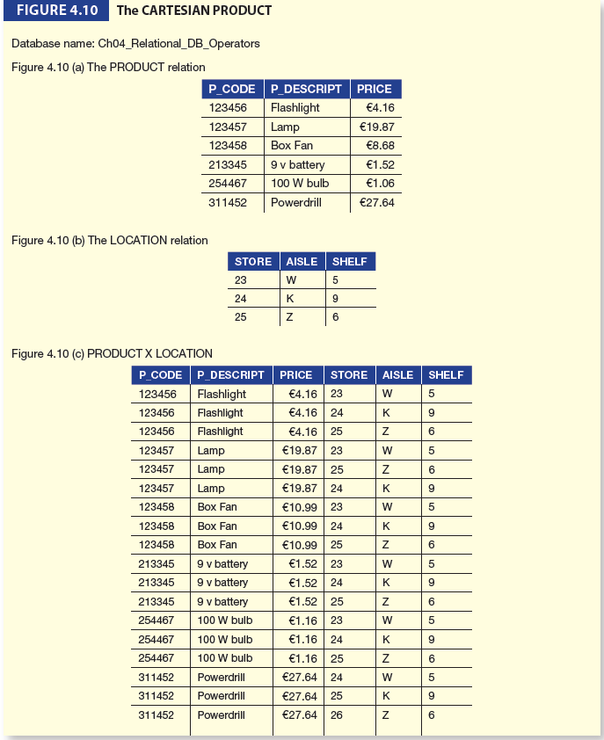
Cartesian product (continued)

Slide 27
Division
The DIVISION operation produces a new relation by selecting the tuples in one relation, R1, that match every row in another relation, R2.
It is essentially the inverse of the CARTESIAN PRODUCT operation, just like the arithmetic divide is the inverse of multiplication.

Slide 28
Division (continued)
DIVISION, denoted by R1 ÷ R2, can be formally defined as:
The DIVISION of two relations R₁(a₁, a₂,.... ,a_{n}) with cardinality i and R₂(b₁, b₂,...., b_{m}) with cardinality j is a relation R₃
with degree k = n – m and cardinality i ÷ j.

Slide 29
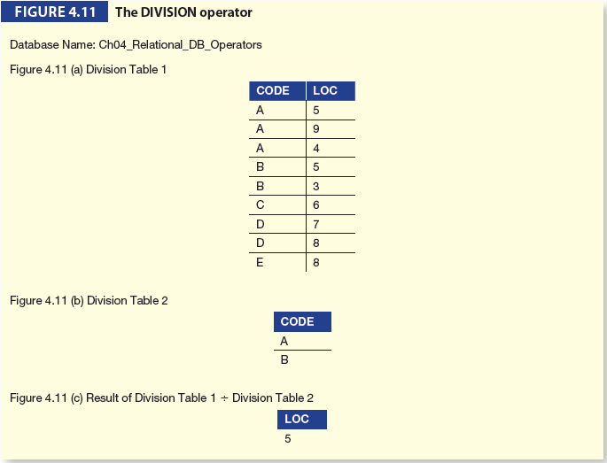
Division (continued)

Slide 30
JOIN operators
Join operators
Allows information to be combined from two or more tables
Real power behind the relational database, allowing the use of independent tables linked by common attributes

Slide 31
Join operators defined
A JOIN Operator may be formally defined as:
The join of two relations R₁(a₁, a₂,.... ,a_{n}) and R₂(b₁, b₂,...., b_{m}) is a relation R₃ with degree k = n + m and attributes
(a₁, a₂,.... ,a_{n}, b₁, b₂,...., b_{m})
that satisfy a specific join condition.

Slide 32
Types of Join
THETA JOIN
EQUIJOIN
NATURAL JOIN
LEFT OUTER JOIN
RIGHT OUTER JOIN
FULL OUTER JOIN

Slide 33
Equijoin
An equijoin is a join that links tables on the basis of an equality condition that compares specified columns of each table.
The outcome of the equijoin does not eliminate duplicate columns, and the condition or criterion used to join the tables must be explicitly defined.
The equijoin takes its name from the equality comparison operator (=) used in the condition.

Slide 34
Equijoin and Theta Join
If any other comparison operator is used the equijoin is called a theta join denoted with the symbol θ (θ- join).
So theta represents a predicate which consists of one of the comparison operators { =, <, <=, >=, < >}.
The equijoin is therefore one special type of theta join.

Slide 35
Computing Equijoins and Theta Joins
Compute R1 X R2.
This first performs a Cartesian product to form all possible combinations of the rows of R1 and R2.
Restrict the Cartesian product to only those rows where the values in certain columns match.

Slide 36
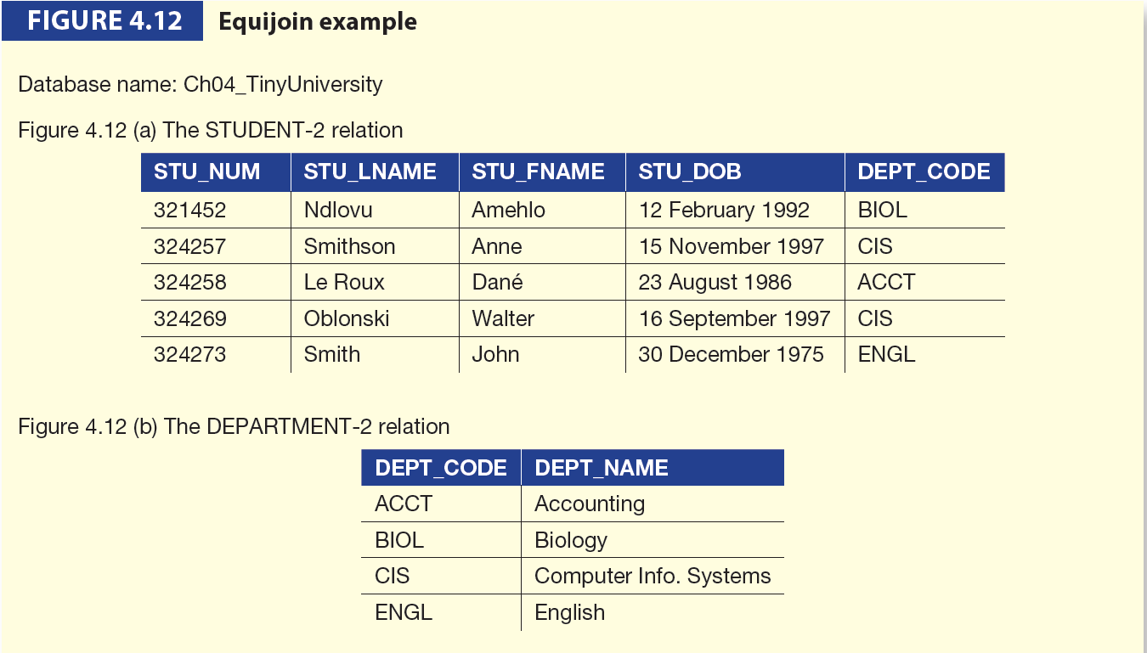
Equijoin Example

Slide 37
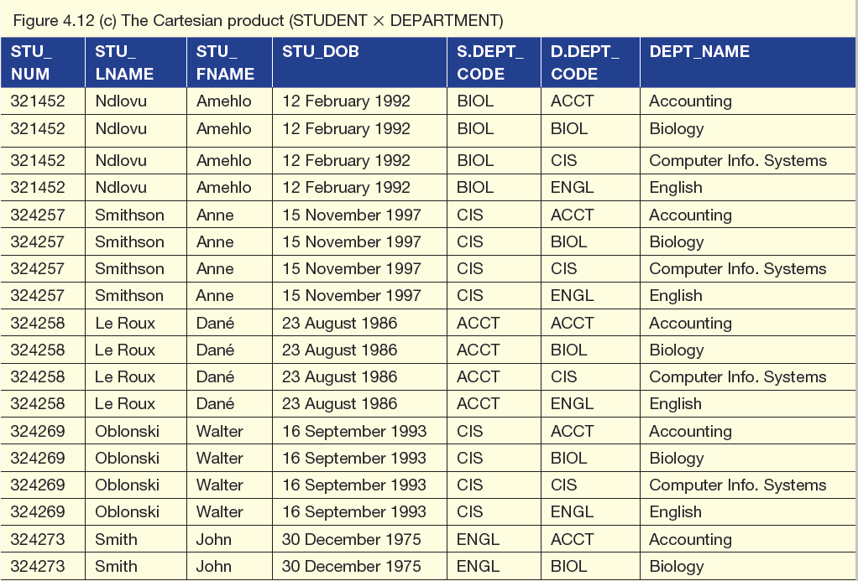
Equijoin Example (continued)

Slide 38
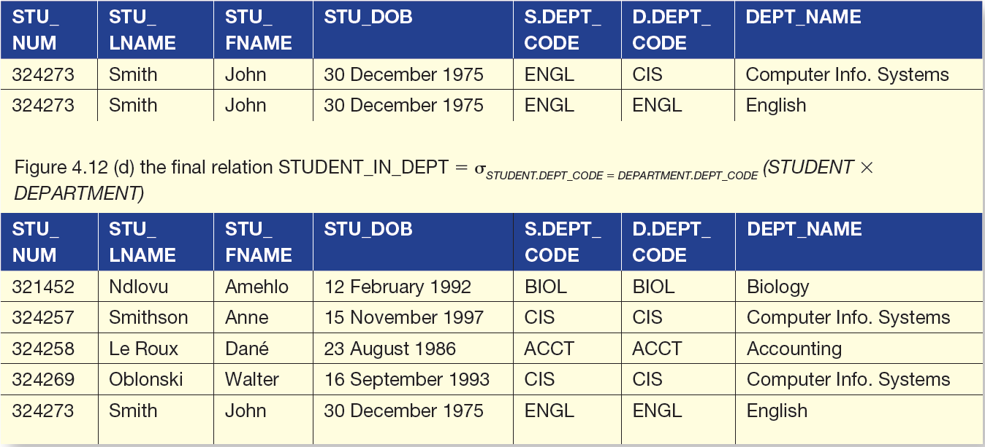
Equijoin Example (continued)

Slide 39
Natural Join
Links tables by selecting only rows with common values in their common attribute(s)
The common column(s) is (are) referred to as the join column(s).
The natural join is in fact an equijoin, however, in addition, we drop the duplicate attributes, so the resulting relation contains one less column than that of the equijoin.

Slide 40
Computing the Natural Join
Compute R₁ X R₂. This first performs a Cartesian product to form all possible combinations of the rows of R₁ and R₂.
Select those tuples where R₁Tuple.y = R₂Tuple.y. Only the rows are selected where the attribute values in the join column(s) are equal.
Perform a PROJECT operation on either R₁.y or R₂.y to the result of step (2), and call it y in the final relation.

Slide 41
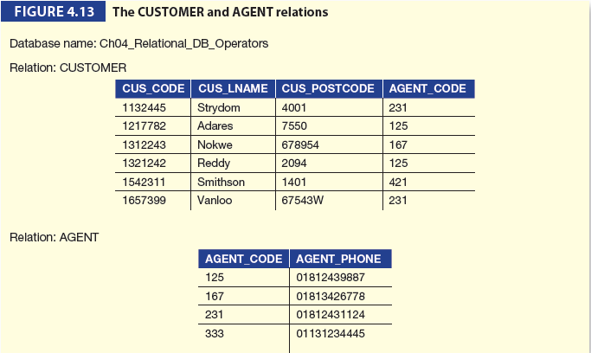
Natural Join Example

Slide 42
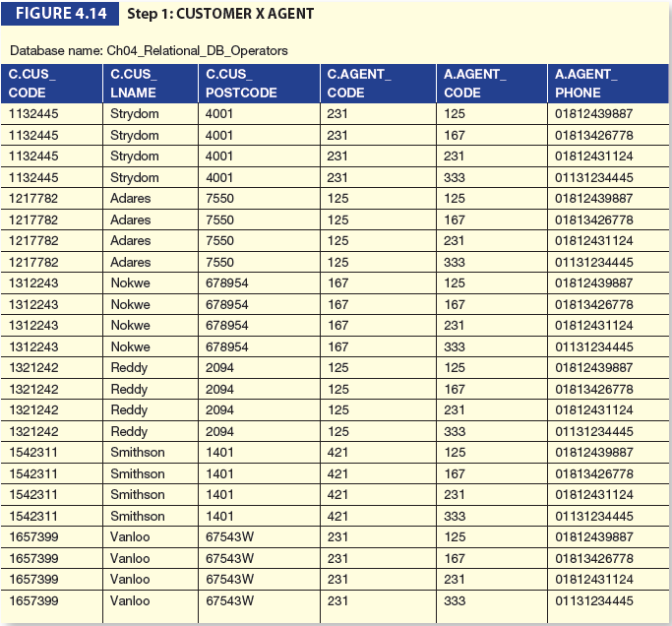
Natural Join Example (continued)

Slide 43
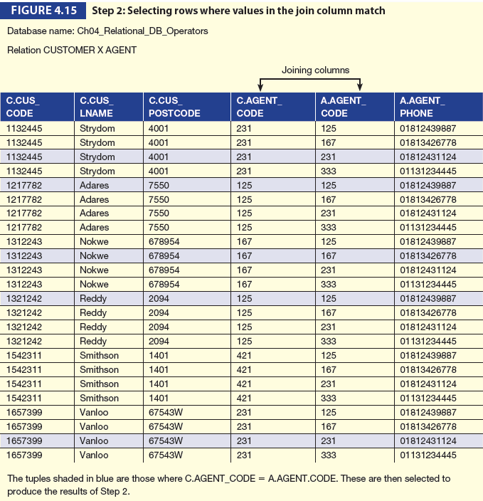
Natural Join Example (cont)

Slide 44
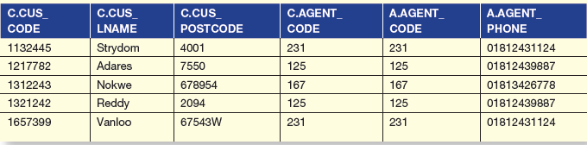
Natural Join Example (continued)

Slide 45
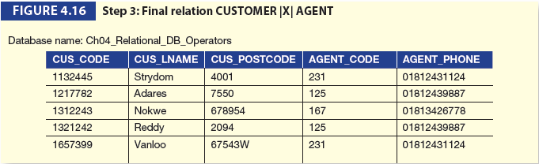
Natural Join Example (continued)

Slide 46
Relational Algebra Operators (continued)
Natural Join:
Final outcome yields table that
Does not include unmatched pairs
Provides only copies of matches
If no match is made between the table rows
the new table does not include the unmatched row

Slide 47
Outer Join
Matched pairs are retained and any unmatched values in other table are left null
In outer join for tables CUSTOMER and AGENT, two scenarios are possible:
Left outer join
Yields all rows in CUSTOMER table, including those that do not have a matching value in the AGENT table
Right outer join
Yields all rows in AGENT table, including those that do not have matching values in the CUSTOMER table

Slide 48



Types of Outer Join
There are three common types of the outer join:
Left outer join – keeps data from the left-hand relation
Right outer join – keeps data from the right-hand relation
Full outer join – keeps data from both relations

Slide 49
Computing a Left Outer Join
Compute R₁ X R₂. This fi rst performs a Cartesian product to form all possible combinations of the rows of R₁ and R₂.
Select those tuples where R₁Tuple.y = R₂Tuple.y.
Select those tuples in R₁ that do not have matching values in R₂, so R₁Tuple.y <> R₂Tuple.y.
Perform a PROJECT operation on either R₁.y or R₂.y to the result of step (2), and call it simply y in the final relation. Finally, project the rest of the attributes in R₁ and R₂, except y, and drop the prefix R₁ and R₂ in the final relation.

Slide 50
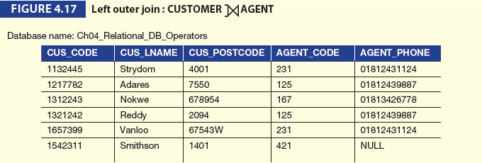
Left Outer Join Example

Slide 51
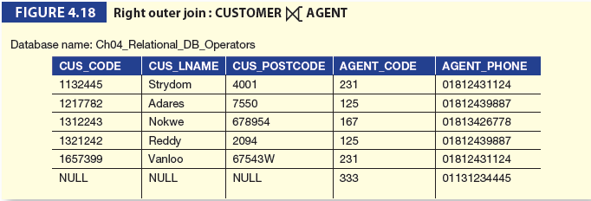
Right Outer Join Example

Slide 52
Building Queries
In order to build a query using a relational algebraic expression you should follow the following steps:
List all the attributes we need to give the answer.
Select all the relations we need, based on the list of attributes.
Specify the relational operators and the intermediate results that are needed.

Slide 53
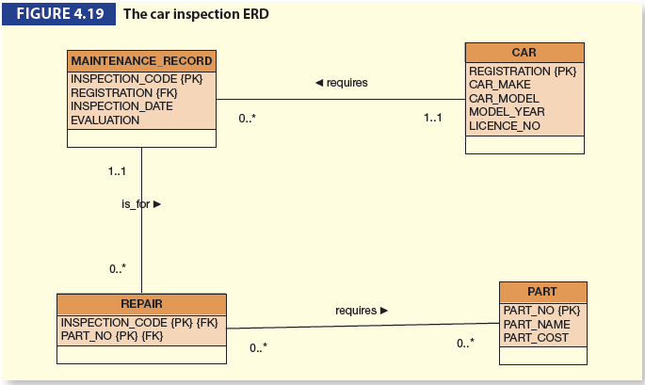

Slide 54
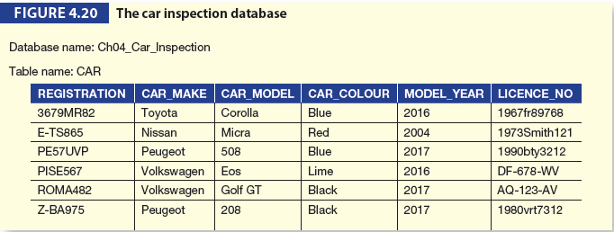
Example: Car Inspection ERD Database

Slide 55
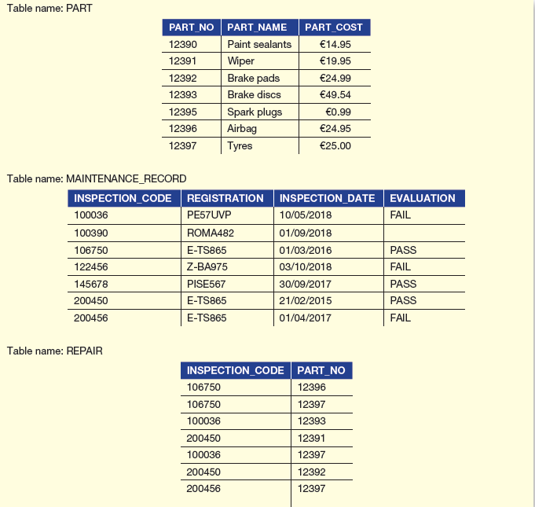
Example: Car Inspection Database

Slide 56
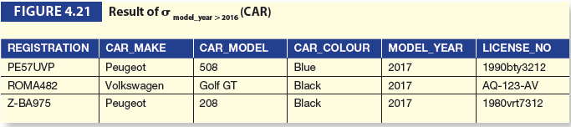
Example 1
‘List all information about cars where the model year is after 2018.’
→ σ _{model_year >2018} (CAR)

Slide 57

Example 2
‘Display all the part names and their prices where the cost of the part is greater than 120.00.’
→ ∏ part_name(σ _{part_cost >20.00} (PART))

Slide 58
Example 3
‘List the car registration and model details and part numbers for all cars where the model year is 2017, where an inspection was carried out after 01/03/2018, which resulted in a part being required for a repair.’

Slide 59

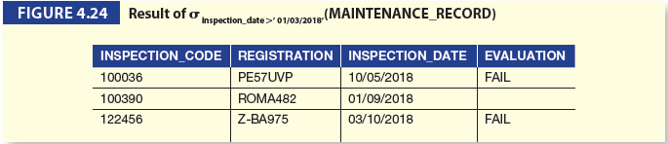
Example 3 (continued)

Slide 60
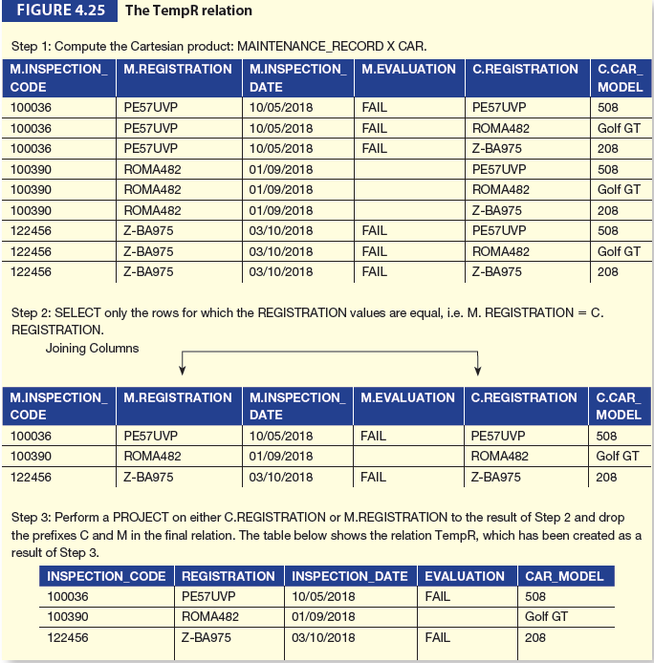
Example 3(continued)

Slide 61
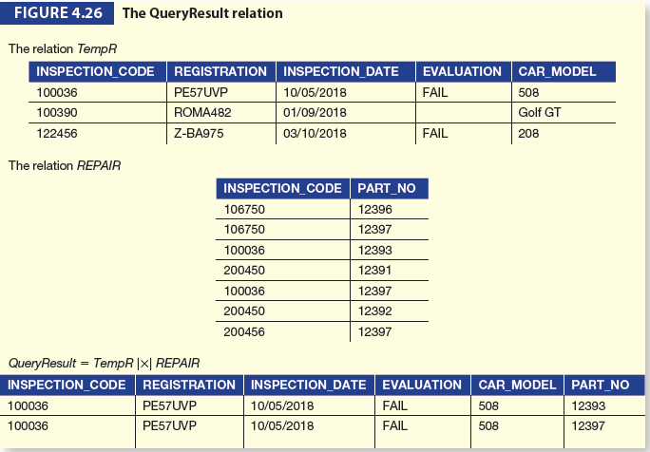
Example 3(continued)

Slide 62

Example 3(continued)

Slide 63
Relational Calculus
Relational calculus is a formal language based upon a branch of mathematical logic called predicate calculus.
There are two types of relational calculus.
Tuple relational calculus allows users to describe what they want, rather than how to compute it.
Domain relational calculus is different from tuple relational calculus as it uses domain variables that take on values from an attribute domain, rather than values for an entire tuple.

Slide 64
Tuple Relational Calculus
Tuple Relational Calculus is a non procedural query language which is used to describe what information is required from the database without giving a specific method for obtaining that information.
When specifying a query in Tuple Relational Calculus we say only what attributes are to be retrieved and not how the query is to be executed.

Slide 65
Tuple Relational Calculus (continued)
In Tuple Relational Calculus, we specify a number of tuple variables where each tuple variable ranges over a database table.
The values of the tuple variables are the actual tuples in the table.
A query in the tuple relational calculus is expressed as
{t|P(t)}
Which represents the set of tuples, T for which predicate, P is true.
Therefore the results of this query are all tuples that satisfy the condition represented by predicate P.

Slide 66
Tuple Relational Calculus (continued)
For example If we wanted to write the following query:
“Find all cars with a model_year >= 2018” using tuple relational calculus we would write:
{C|C ∈ Car ∧ C.MODEL_YEAR>=2018}
This query means return the set of tuples, t, where t belongs to the Car relation and the model_year for year t is greater than 2018.

Slide 67
Tuple Relational Calculus (continued)
A formulae in tuple relational calculus consists of predicate calculus atoms. An atom has one of the following forms:
(i) R(t) where t is a tuple variable and R is a relation name.
(ii) t.A oper s.B
where t and s are tuple variables,
A and B are attributes and
oper is a comparison operator.
(iii) t.A oper const
where t is a tuple variable,
A is an attribute,
oper is a comparison operator, and
const is a constant.
Each of these types of atoms evaluates to either TRUE or FALSE for a specific combination of tuples.
Every atom has a truth value.

Slide 68
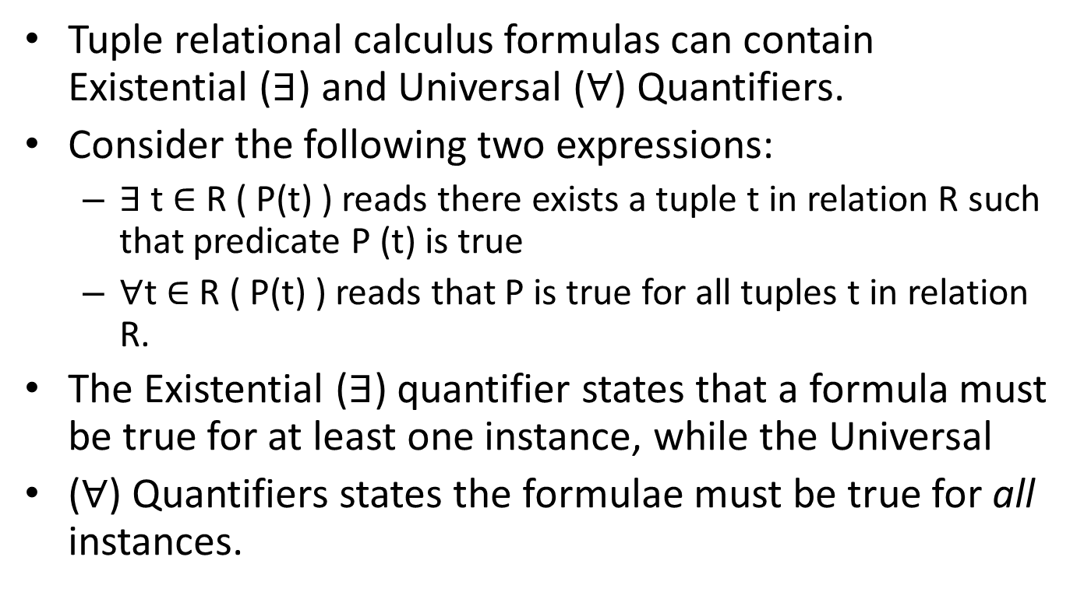
Tuple Relational Calculus (continued)
Tuple relational calculus formulas can contain Existential ($∃$) and Universal ($∀$) Quantifiers.
Consider the following two expressions:
$∃$ t ∈ R ( P(t) ) reads there exists a tuple t in relation R such that predicate P (t) is true
$∀$t ∈ R ( P(t) ) reads that P is true for all tuples t in relation R.
The Existential ($∃$) quantifier states that a formula must be true for at least one instance, while the Universal
($∀$) Quantifiers states the formulae must be true for all instances.

Slide 69
Building a tuple relational calculus expression
To specify a tuple relational calculus expression, follow the following steps:
(i) Specify the range relation R of each tuple variable t. In the form of R(t).
(ii) Specify a condition to select particular combinations of tuples.
(iii) Specify a set of attributes to be retrieved.

Slide 70
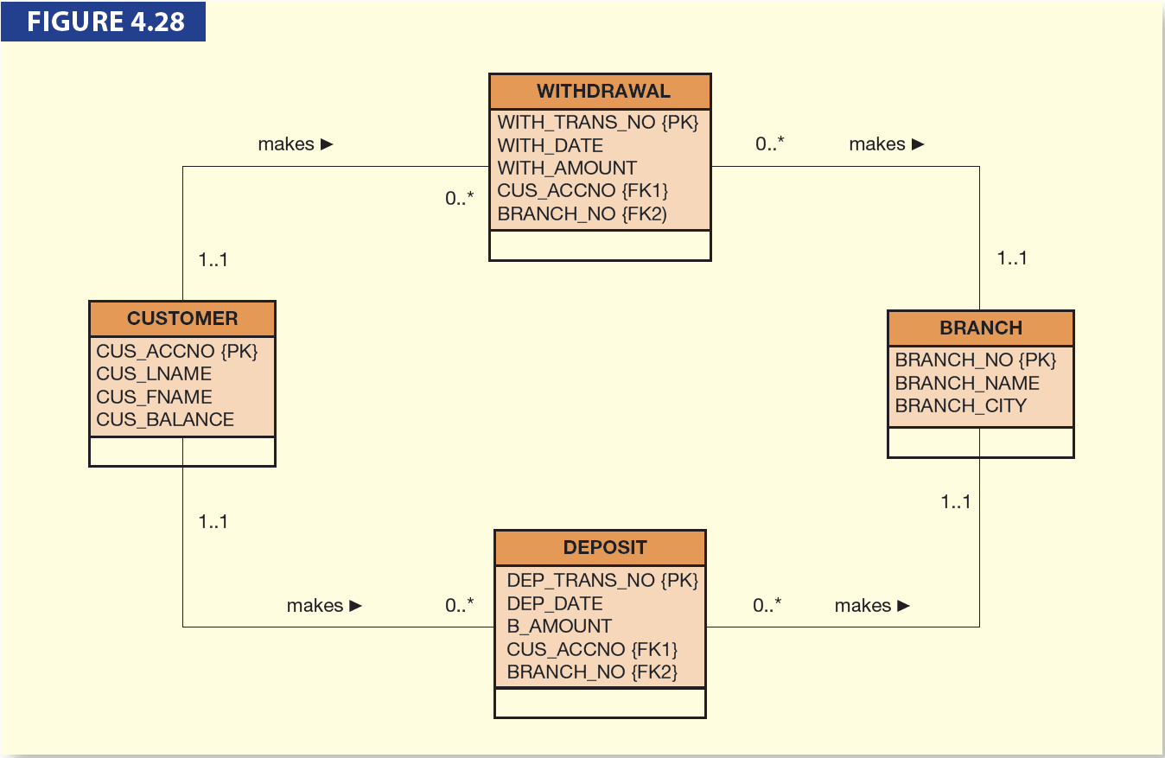
Building a tuple relational calculus expression (continued)

Slide 71
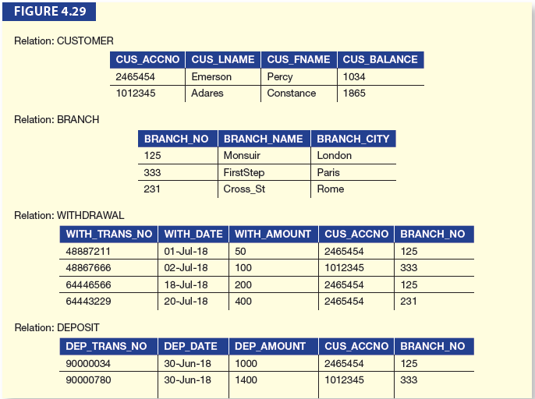
Building a tuple relational calculus expression (continued)

Slide 72
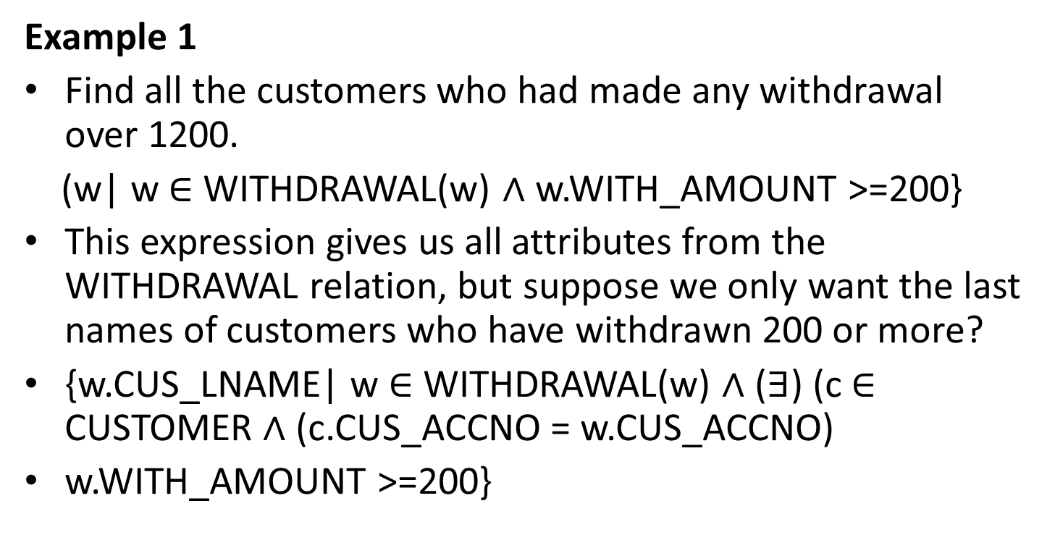
Building a tuple relational calculus expression (continued)
Example 1
Find all the customers who had made any withdrawal over 1200.
(w| w ∈ WITHDRAWAL(w) ∧ w.WITH_AMOUNT >=200}
This expression gives us all attributes from the WITHDRAWAL relation, but suppose we only want the last names of customers who have withdrawn 200 or more?
{w.CUS_LNAME| w ∈ WITHDRAWAL(w) ∧ ($∃$) (c ∈ CUSTOMER ∧ (c.CUS_ACCNO = w.CUS_ACCNO)
w.WITH_AMOUNT >=200}

Slide 73
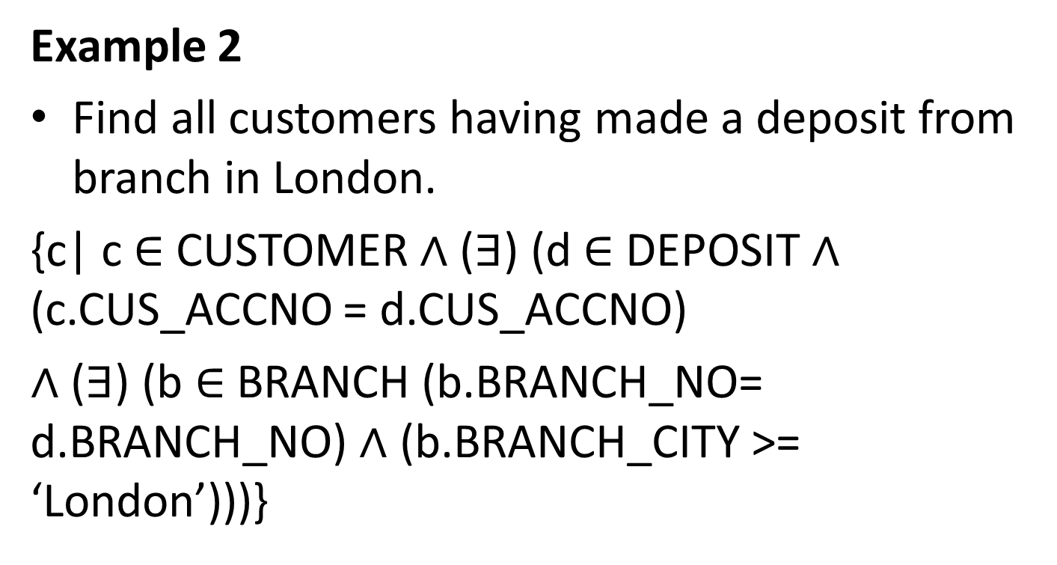
Building a tuple relational calculus expression (continued)
Example 2
Find all customers having made a deposit from branch in London.
{c| c ∈ CUSTOMER ∧ ($∃$) (d ∈ DEPOSIT ∧ (c.CUS_ACCNO = d.CUS_ACCNO)
∧ ($∃$) (b ∈ BRANCH (b.BRANCH_NO= d.BRANCH_NO) ∧ (b.BRANCH_CITY >= ‘London’)))}

Slide 74
Domain Relational Calculus
Domain relational calculus is classed as a nonprocedural query language which is seen to equivalent in power to tuple relational calculus.
A general expression in domain relational calculus is of the form
{<x1, x2,…., xn> | P(x1, x2,…., xn)}
Where x1, x2,…., xn represent domain variables. P represents formulae composed of atoms, as was the case in tuple relational calculus.

Slide 75
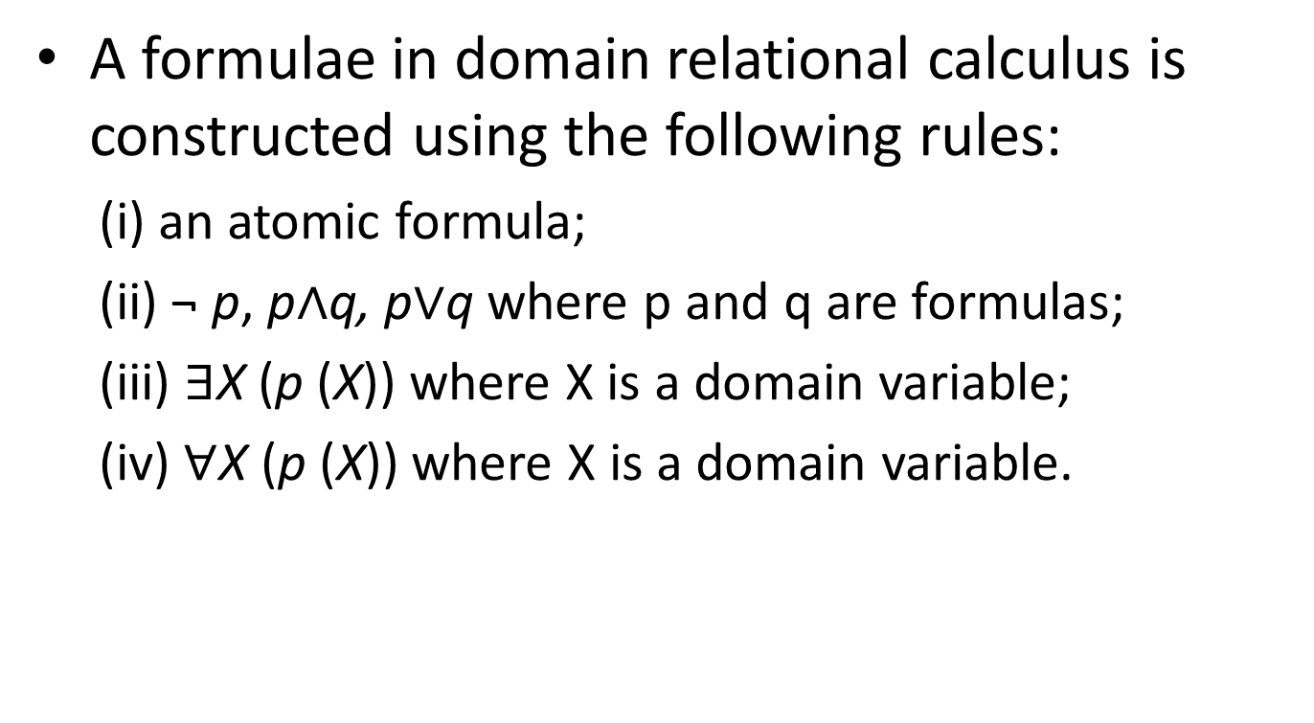
Domain Relational Calculus (continued)
A formulae in domain relational calculus is constructed using the following rules:
(i) an atomic formula;
(ii) ¬ p, p∧q, p∨q where p and q are formulas;
(iii) $∃$X (p (X)) where X is a domain variable;
(iv) $∀$X (p (X)) where X is a domain variable.

Slide 76
Domain Relational Calculus (continued)
Example 1
Find all customers with a balance greater than 1500.
{CUS_ACCNO, CUS_LNAME,CUS_BALANCE| ((CUS_ACCNO, CUS_LNAME, CUS_BALANCE ∈
CUSTOMER) ∧ CUS_BALANCE > 500)}

Slide 77
Domain Relational Calculus (continued)
Example 2
Find all customers with a balance greater than 1500 and have deposited money at branch 125.
{CUS_ACCNO, CUS_LNAME, CUS_BALANCE| ((CUS_ACCNO, CUS_LNAME, CUS_BALANCE ∈
CUSTOMER) ∧ CUS_BALANCE > 500) ∧ ∃ DEPOSIT.BRANCH_NO (DEPOSIT.BRANCH_NO ∈ DEPOSIT)
∧ DEPOSIT.BRANCH_NO = CUSTOMER.BRANCH_NO ∧ CUSTOMER.BRANCH_NO = 125}

Slide 78
Domain Relational Calculus (continued)
Example 3
List the branches where there have been no deposits.
{BRANCH_NO, BRANCH_NAME, BRANCH_CITY| (({BRANCH_NO, BRANCH_NAME, BRANCH_
CITY ∈ BRANCH) ∧ (∃ BRANCH.BRANCH_NO) BRANCH(BRANCH_NO, BRANCH_NAME,
BRANCH_CITY) ∧ (∃ DEPOSIT.BRANCH_NO) (DEPOSIT.BRANCH_NO ∈ DEPOSIT) ∧ (DEPOSIT.
BRANCH_NO = BRANCH.BRANCH_NO)}

Slide 79
Summary
One of the key components of the relational model is the relation which allows data to be stored within the database in a structured manner.
Relational algebra and relational calculus are the mathematical basis for ‘relational databases’.
Relational algebra is a collection of formal operations which act on relations to produce new relations as a result.

Slide 80
Summary (continued)
The relational model supports the eight relational algebra operators originally defined by Codd.
These are known as SELECT (or RESTRICT), PROJECT, JOIN, PRODUCT, INTERSECT, UNION, DIFFERENCE and DIVIDE.

Slide 81
Summary (continued)
User queries can be written as relational algebraic expressions. In order to write such as an expression, the following steps should be followed:
List all the attributes we need to give the answer.
Select all the relations which we need, based on the list of attributes.
Specify the relational operators and the intermediate results that are needed.

Slide 82
Summary (continued)
Tuple relational calculus allows users to describe what they want, rather than how to compute it and underlines the appearance of Structured Query Language (SQL).
Expressions in tuple relational calculus return tuples for which a given predicate is true.
Domain Relational Calculus is different from tuple relational calculus as it uses domain variables that take on values from an attribute domain.

Slide 83
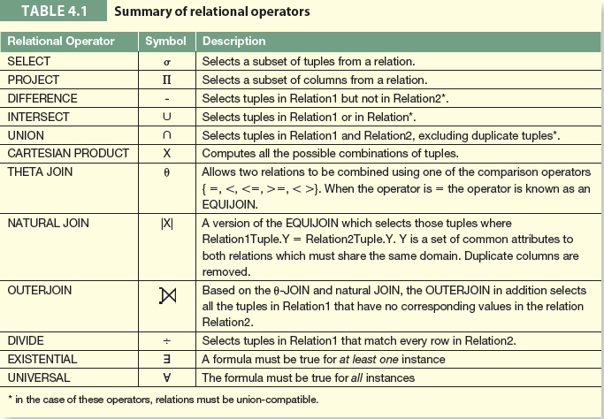
Summary of Relational Operators

